Slide 1
DARPA TC E3
Attack Labeling Overview

Slide 2
Foreword
Attack subgraphs might not be 100% complete (I may have missed some of the “connector” events between attack stages)
For ADS purposes I think this is mostly fine, as a few missing edges out of a few thousand or so will cause limited statistical errors
For attack reconstruction, this will be more problematic
Generated primarily via process subtree tracing from known points of intrusion
Once again, good for ADS: we have all of the events associated with anomalous processes
Bad for attack reconstruction: lots of noise and behaviors that are part of normal process behavior
For presentation purposes, reduced all parallel edges in subgraphs
Ground Truth Section 3: Nation State, Section 4: Common Threat

Slide 3
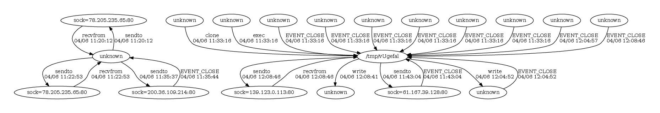
Ground Truth 3.1: CADETS nginx
|V| = 19, |E| = 964

Slide 4
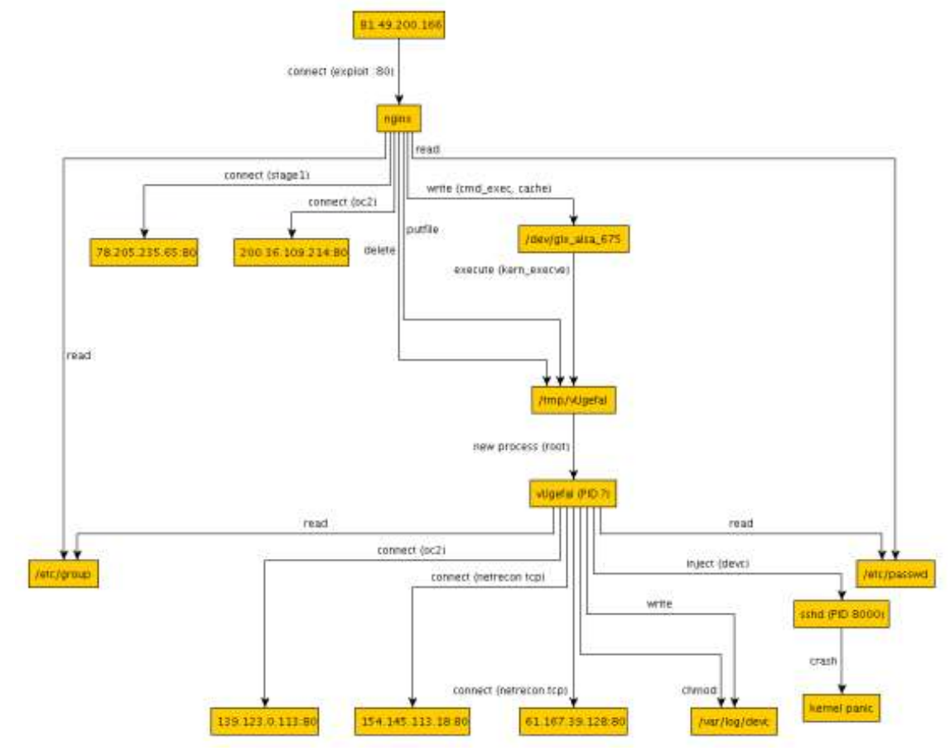
Ground Truth 3.1: CADETS nginx
81.49.200.168
nginx
/dev/gtx_alsa_675
/tmp/vUgefal
/tmp/vUgefal

Slide 5
Ground Truth 3.1: CADETS nginx
Missing connection between nginx and gtx_alsa
Missing initial malicious ad server (81.49.200.168)
Some missing attack behaviors are probably due to lost capture
gtx_alsa
/tmp/vUgefal
nginx

Slide 6
3.2: TRACE firefox: Failed Attack
|V| = 54, |E| = 9,232,178. This attack crashed TRACE due to excessive logs
These are all mmaps to an unhandled node type on my end

Slide 7
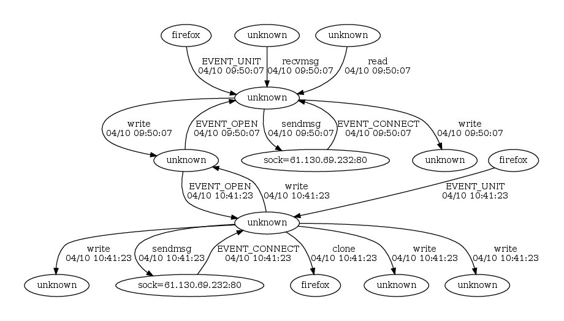
3.2: TRACE firefox: Failed Attack
|V| = 54, |E| = 9,232,178. This attack crashed TRACE due to excessive logs
Shellcode server
BEEP execution unit
Malicious binary?

Slide 8
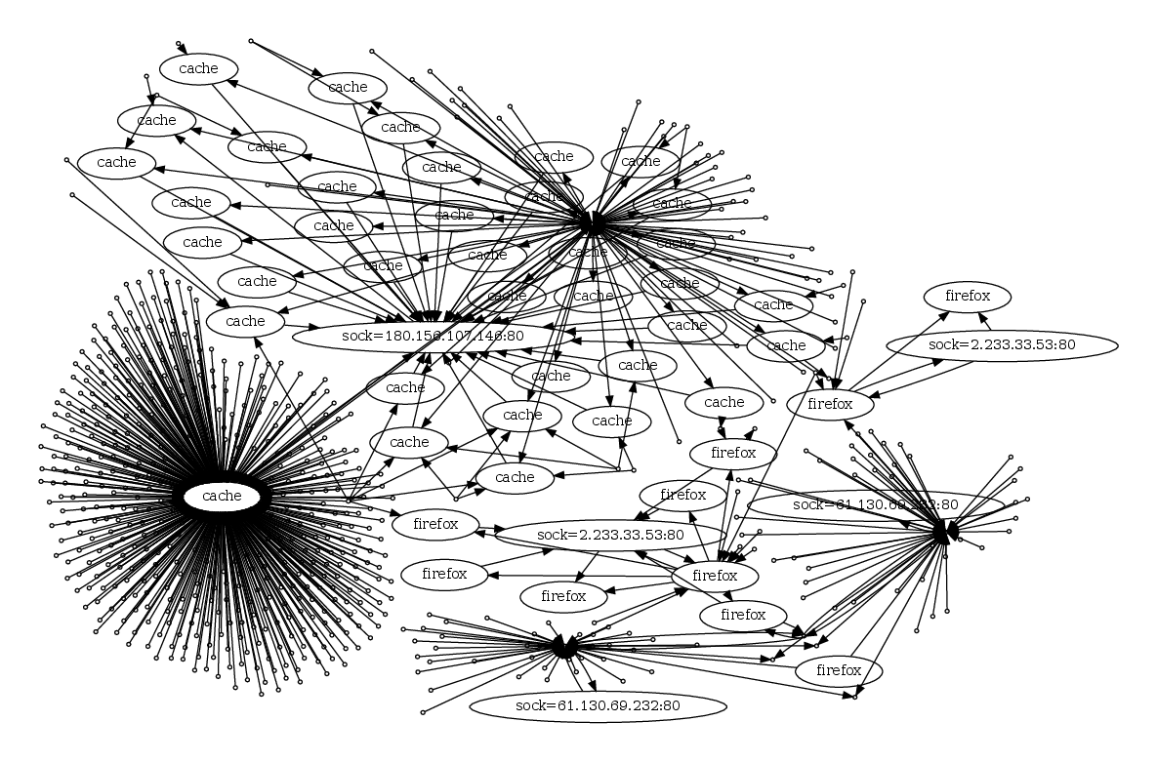
3.2 TRACE firefox: Successful Attack
|V| = 668, |E| = 3,597
Hard to make sense of this

Slide 9
“Failed a few times before working”
Probably a BEEP unit
“cache” is malicious

Slide 10
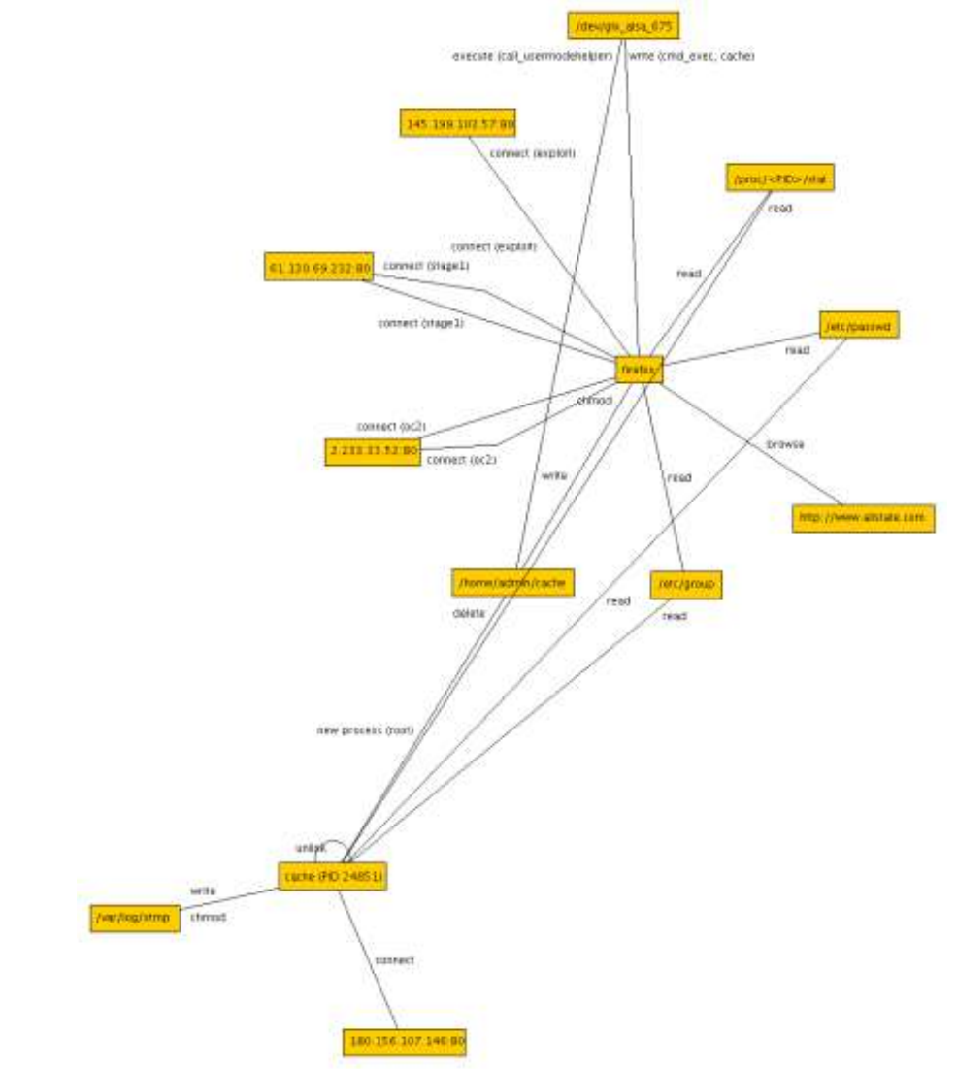
3.2 TRACE firefox: Successful Attack
/dev/glx_alsa_475
Malicious IP addresses
/proc/PID/???
firefox
/home/admin/cache
Malicious ad server
Not in logs
/var/log/xtmp Not in logs
cache

Slide 11
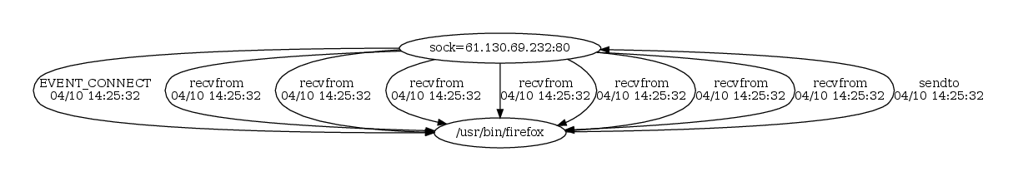
3.3 THEIA firefox: Failed allstate.com Attack
|V| = 2, |E| = 9

Slide 12
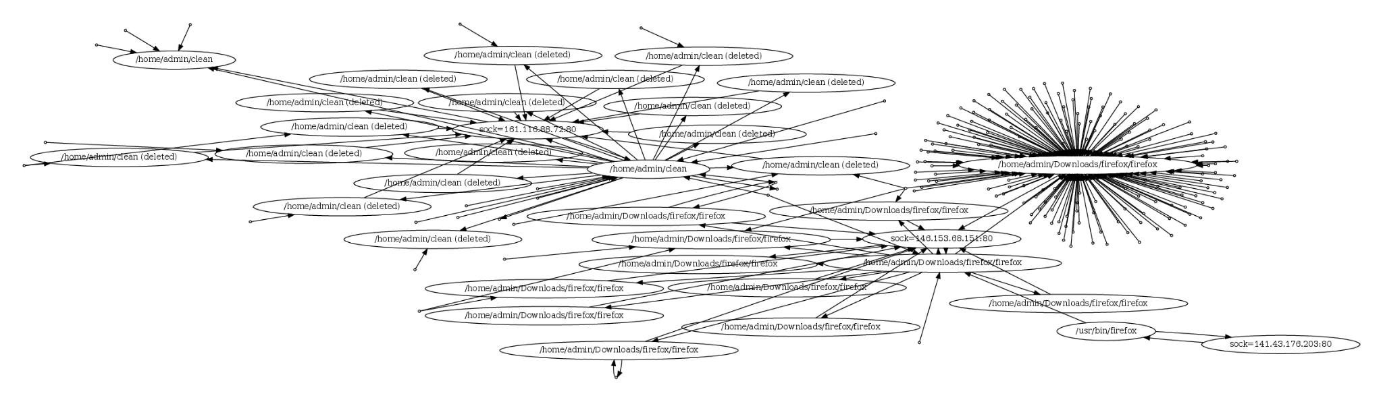
3.3 THEIA firefox: Failed gatech.edu Attack
|V| = 223, |E| = 1,310
Malicious binary
“Crashed a few times before the exploit finally worked”
Initial intrusion

Slide 13
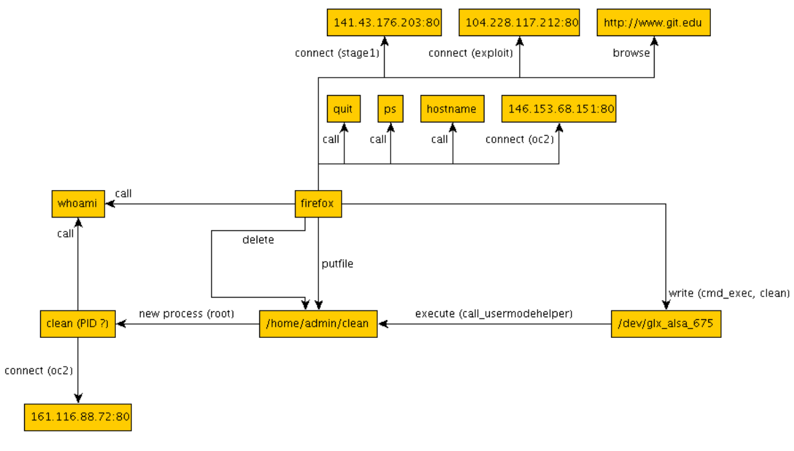
3.3 THEIA firefox: Failed gatech.edu Attack
Should be gatech.edu,
but not in logs anyways
This process appears to have no parent

Slide 14
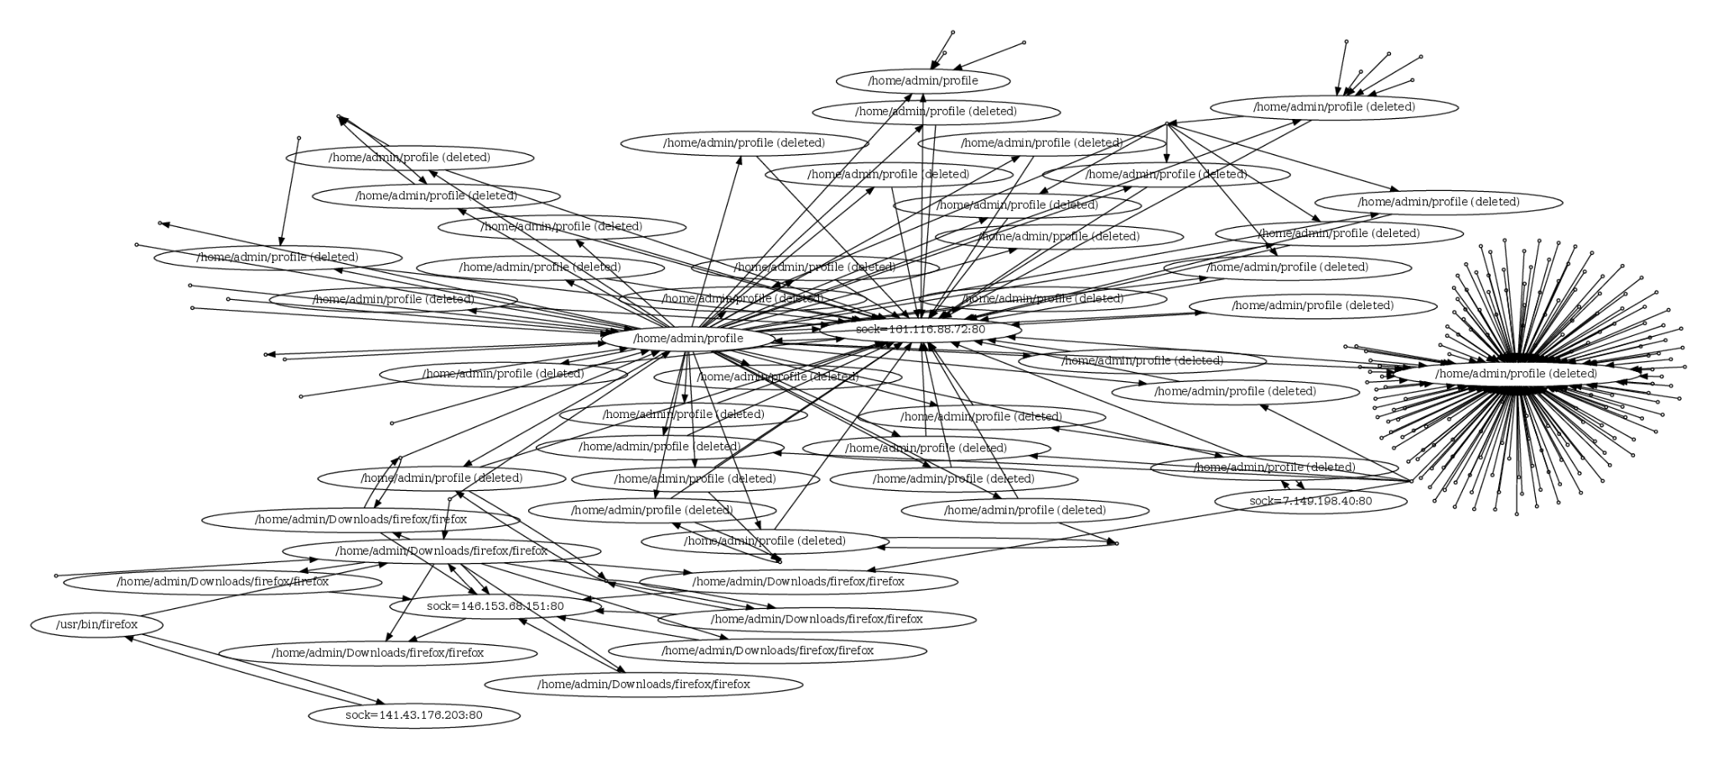
3.3 THEIA firefox: Successful gatech.edu Attack
|V| = 246, |E| = 1,478
Malicious binary
Initial intrusion
Connection was left open when attack succeeded

Slide 15
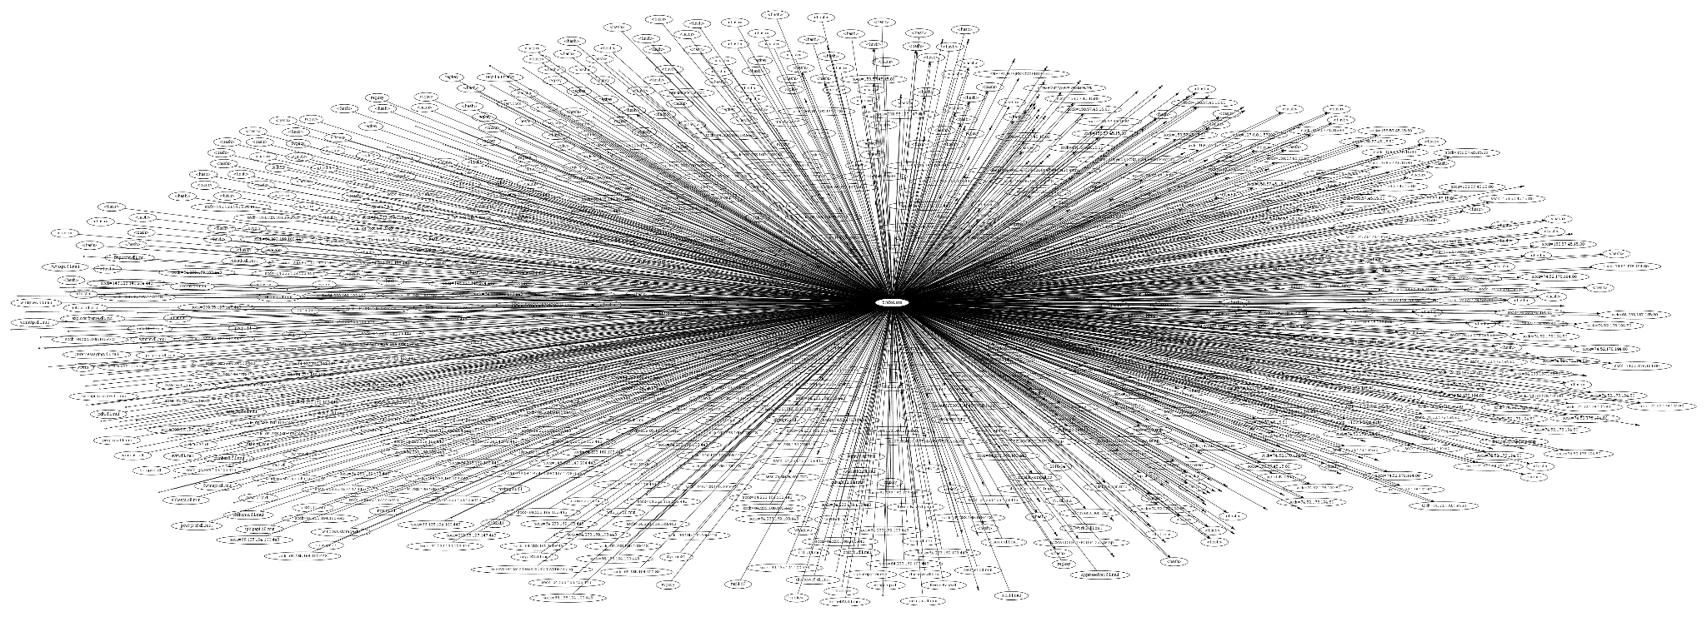
3.4 FiveDirections firefox: Successful Attack
|V| = 1,040, |E| = 20,250
firefox.exe
This attack involved exfiltration, hence the amount of vertices

Slide 16
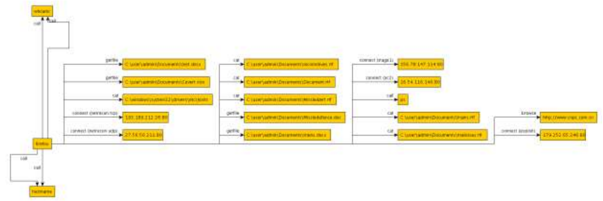
3.4 FiveDirections firefox: Successful Attack
This attack involved exfiltration, hence the amount of vertices
firefox

Slide 17
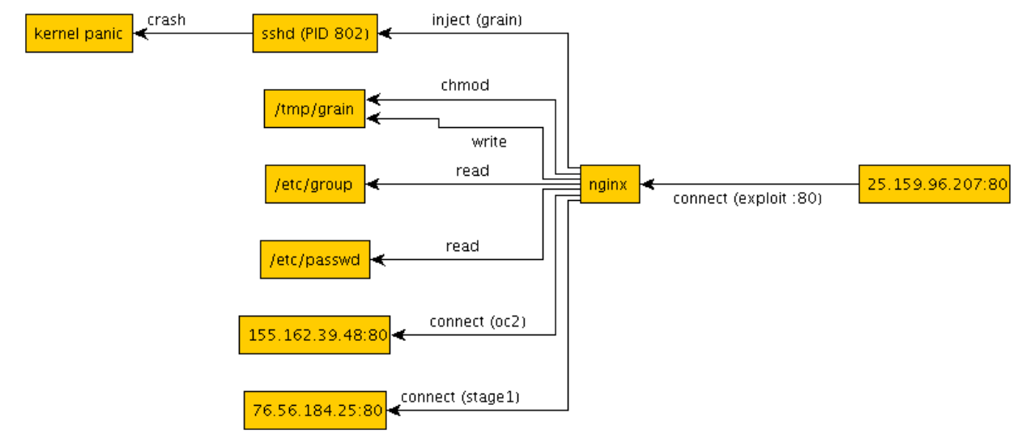
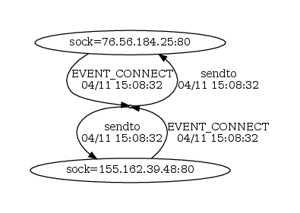
3.8: CADETS nginx: Failed Attack
|V| = 3, |E| = 355
nginx

Slide 18
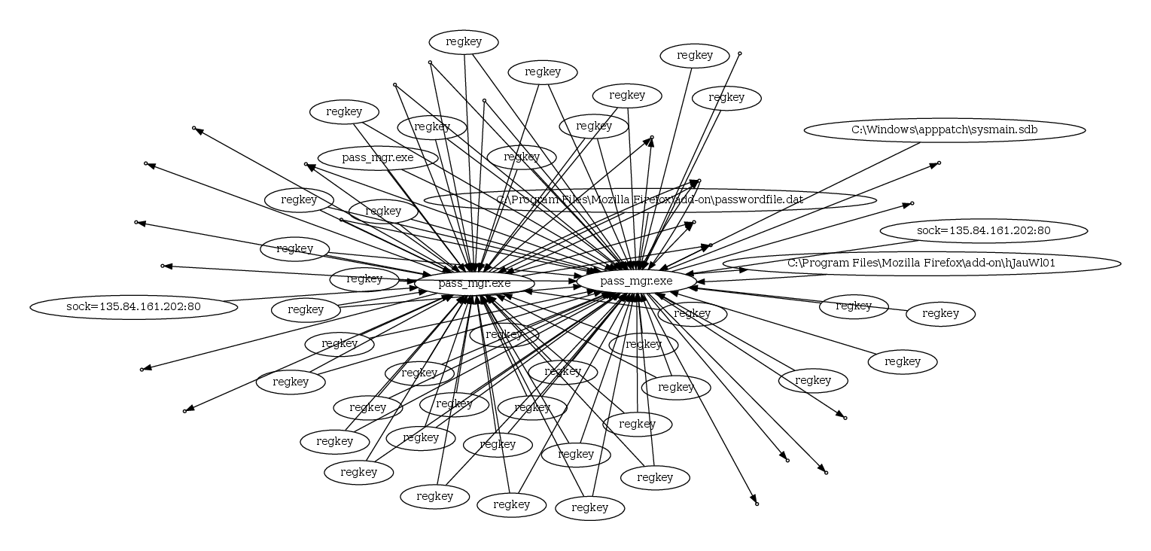
3.10: FiveDirections extension: Failed Attack
|V| = 69, |E| = 375
Real registry keys elided to save space

Slide 19
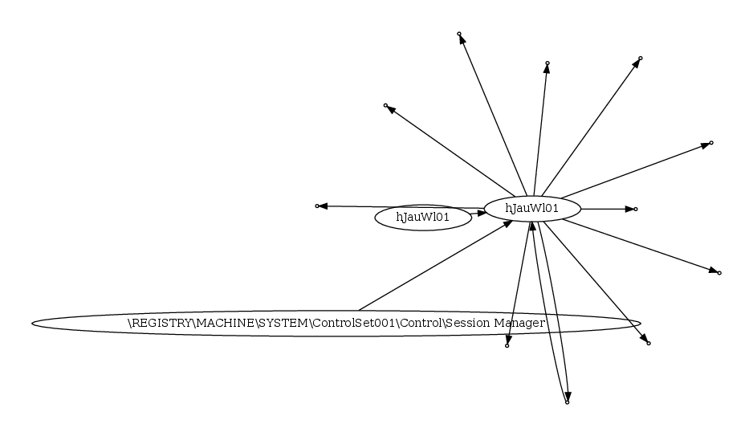
3.10: FiveDirections extension: Successful Attack?
|V| = 14, |E| = 69
Ground truth claims Drakon (the malware) failed to run, but it actually shows up in the logs

Slide 20
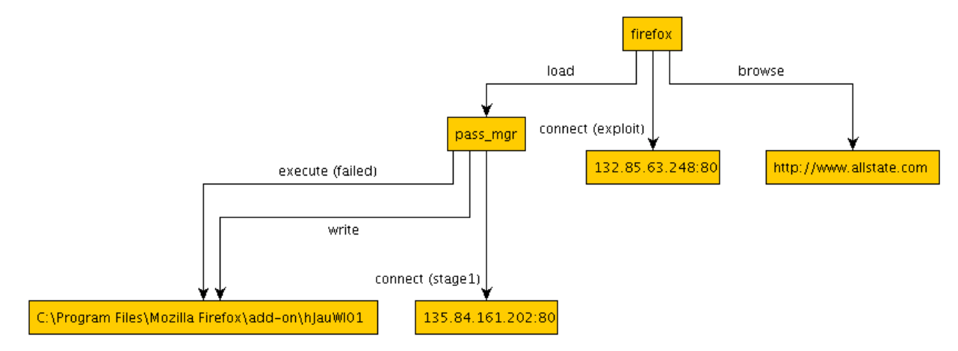
3.10: FiveDirections extension: Ground Truth
Not true in the logs

Slide 21
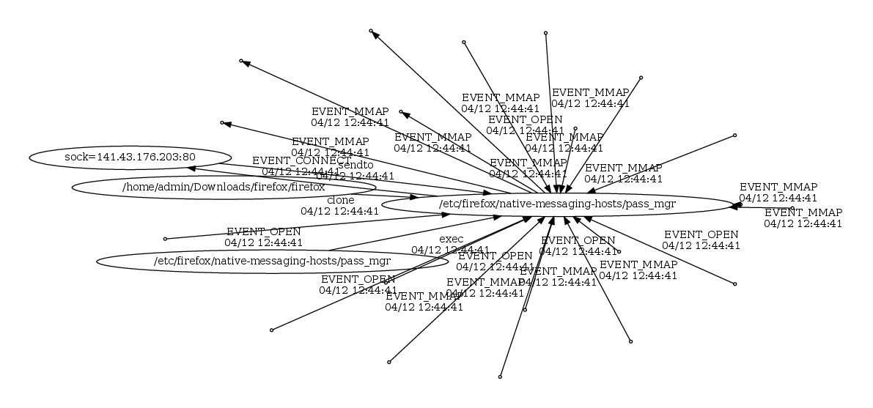
3.11: THEIA extension: Failed Attack
|V| = 24, |E| = 560

Slide 22
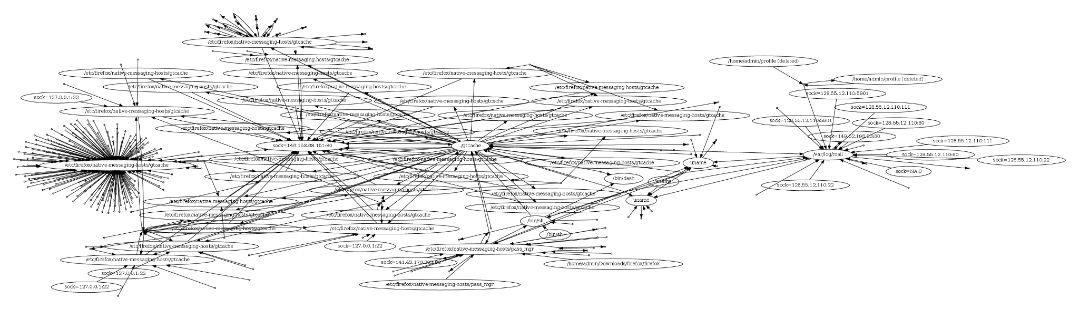
3.11: THEIA extension: Successful Attack
|V| = 25595, |E| = 65518. This attack involve port scanning, so is larger
After collapsing all “NA:0” sockets, new size is |V| = 318, |E| = 65518
gtcache (new attack)
/home/admin/profile (old attack)
micro apt port scan
Initial intrusion of pass_mgr

Slide 23
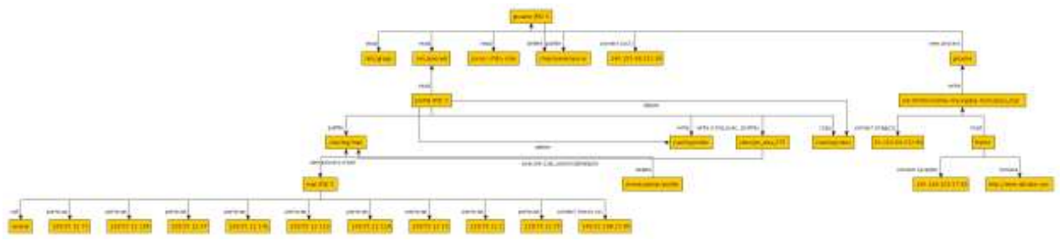
3.11 THEIA extension: Ground Truth

Slide 24
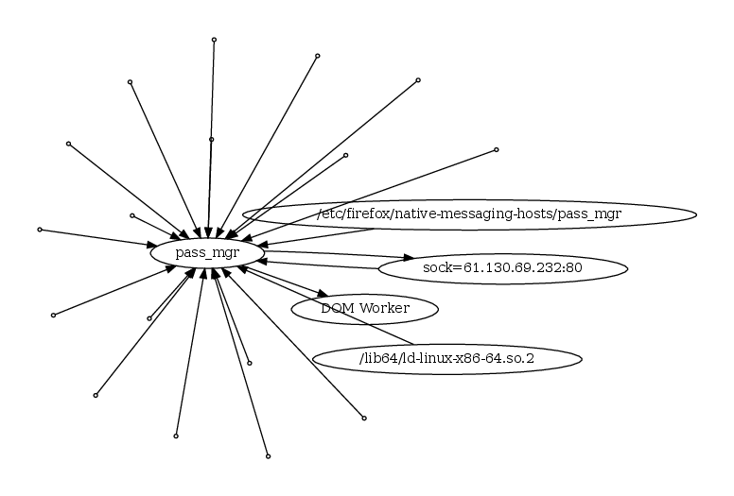
3.12: TRACE extension: Failed Attack
|V| = 22, |E| = 240,401,611 (!)
Ground truth indicates TRACE hanged forever, probably due to log DoS
The quarter billion edges are all between sock=61.130.69.232:80 and pass_mgr

Slide 25
3.13: CADETS nginx: Successful Attack
|V| = 12881, |E| = 14505. Involved many repeated attempts and port scanning

Slide 26
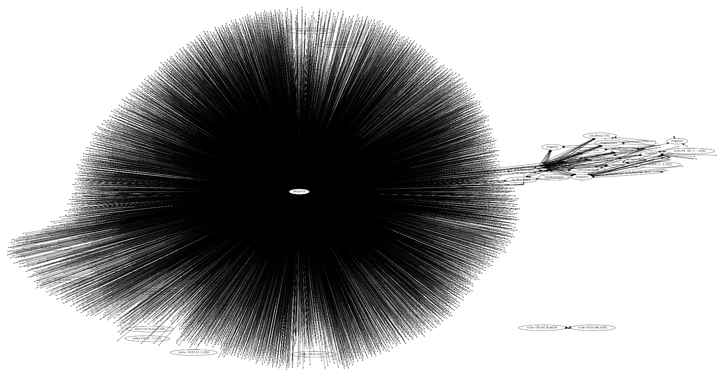
/tmp/test (final attempt)
Port scanning
Earlier attempts (~8) resulting in malware
Failed attempt

Slide 27
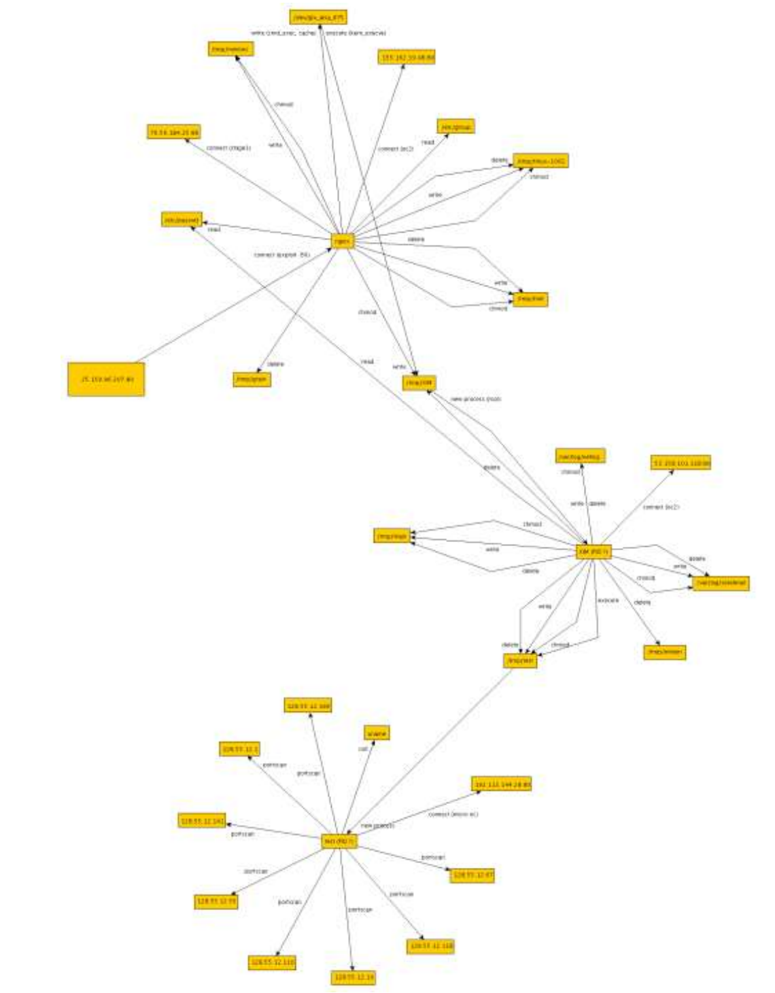
3.13: CADETS ground truth
Can see some of the attempts here

Slide 28
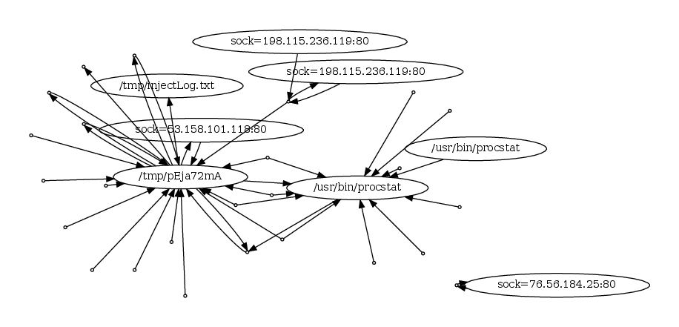
3.14: CADETS nginx: Successful Attack
“libdrakon”, i.e., server of malicious binary
|V| = 33, |E| = 20,418
Shellcode server
Not sure why it’s detached
Malicious process

Slide 29
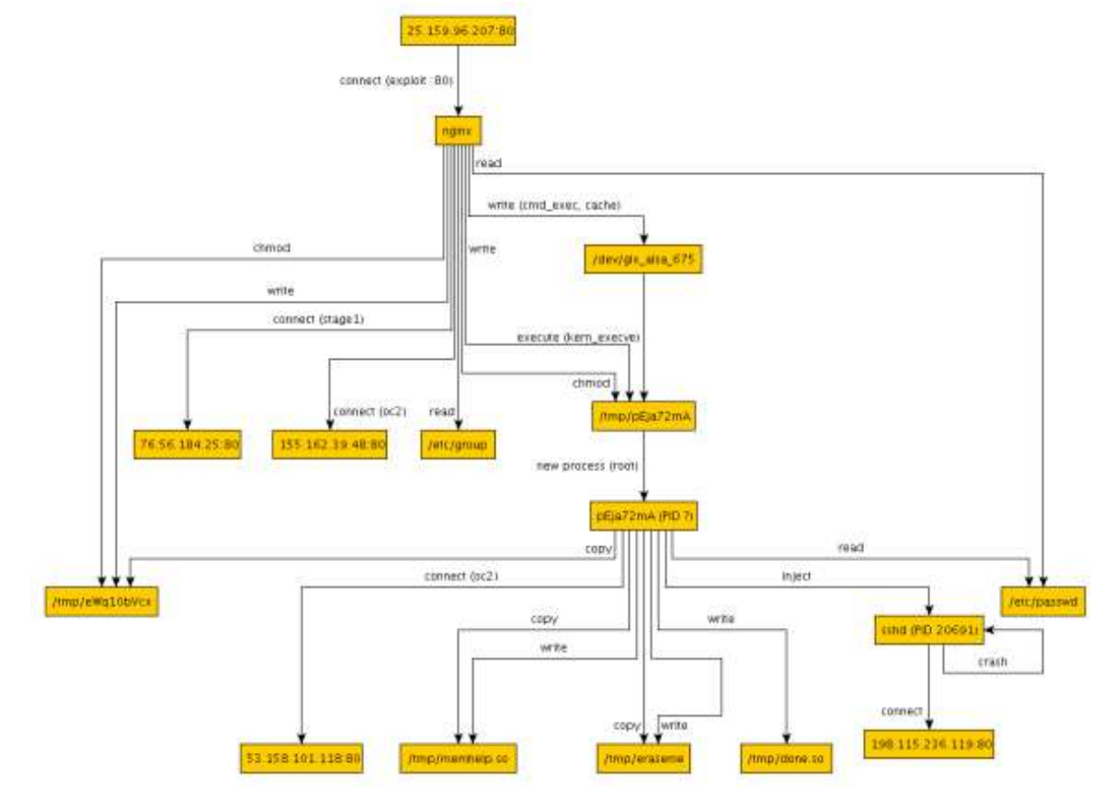
3.14: CADETS nginx: Ground Truth

Slide 30
3.15: TRACE “pine”: Successful Attack
|V| = 1,548, |E| = 4,399. Large due to port scanning
Ground truth description for this attack is completely wrong for some reason
It seems to be describing the Common Threat pine attack that happens later
The attack notes accurately describe this attack on the malicious extension

Slide 31
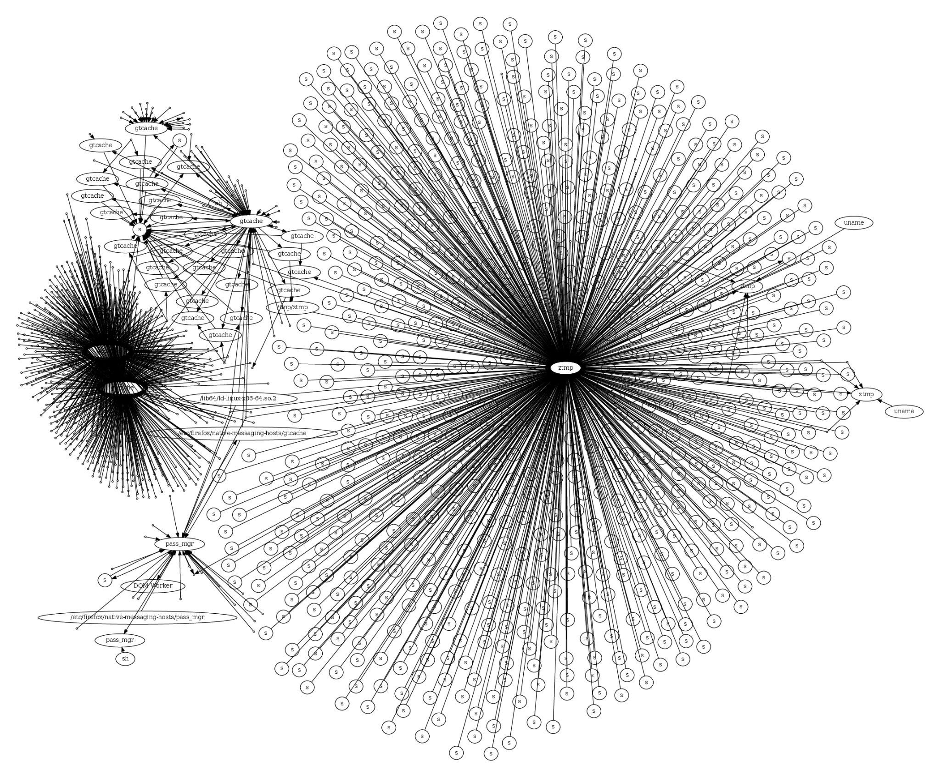
Socket names elided to “s”
gtcache
Intermediate malicious process
ztmp
Port scanning
Initial intrusion from pass_mgr

Slide 32
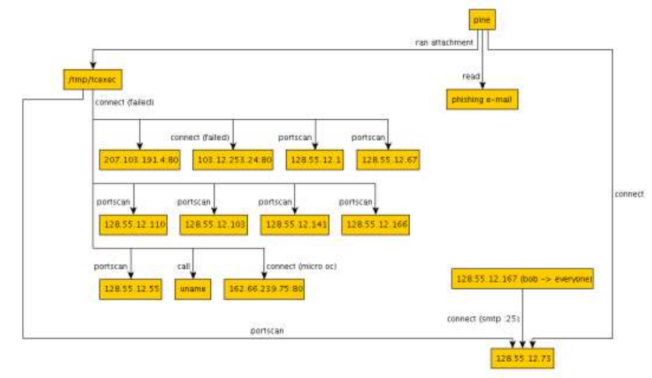
3.15: TRACE “pine”: Ground Truth
This is the wrong attack!
pine
/tmp/tcexec
Phishing e-mail

Slide 33
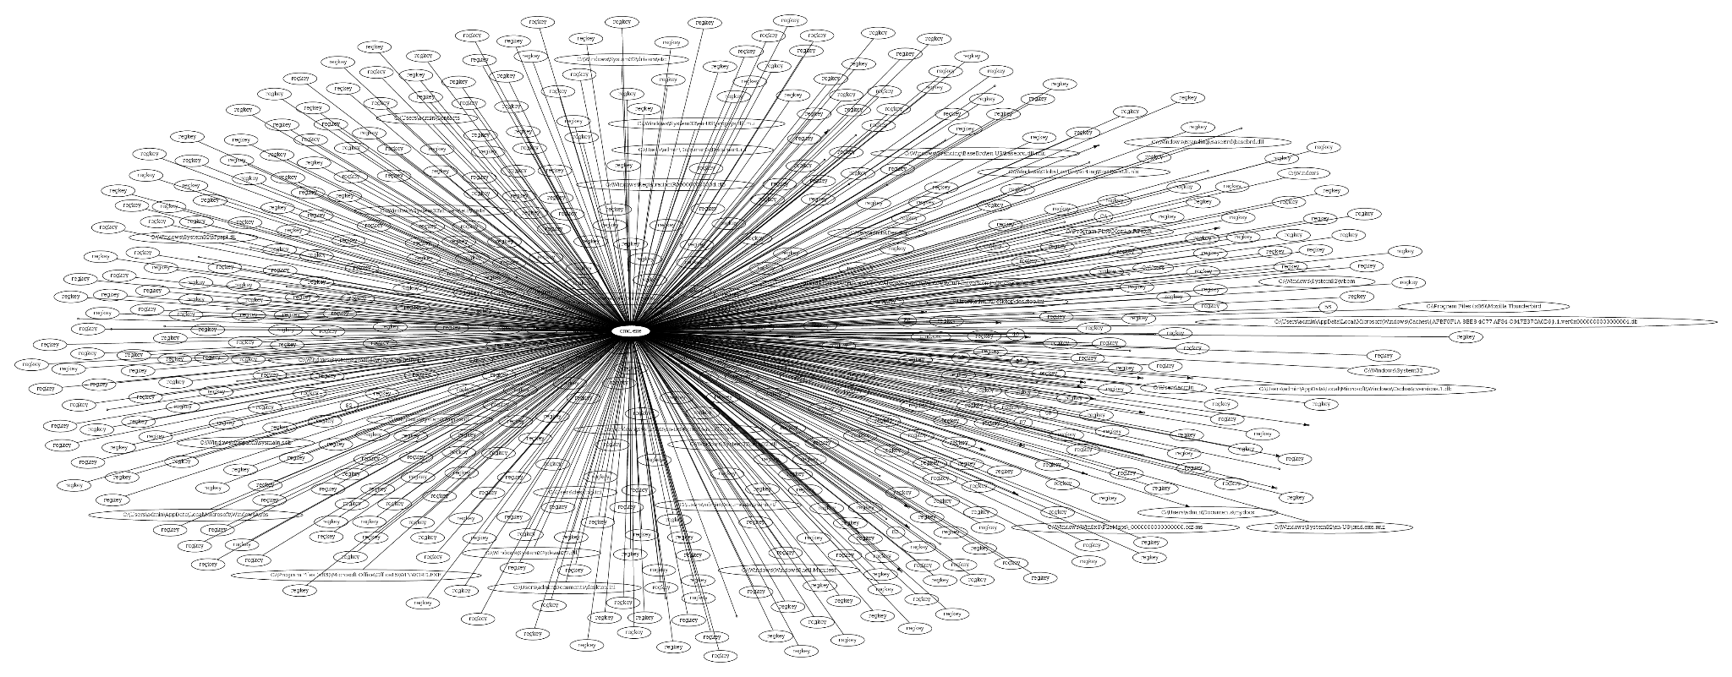
4.4: FiveDirections excel: Partial Attack (cmd)
|V| = 630, |E| = 1,694. Had trouble connecting these two parts together
Thunderbird
(email client)
Malicious cmd.exe

Slide 34
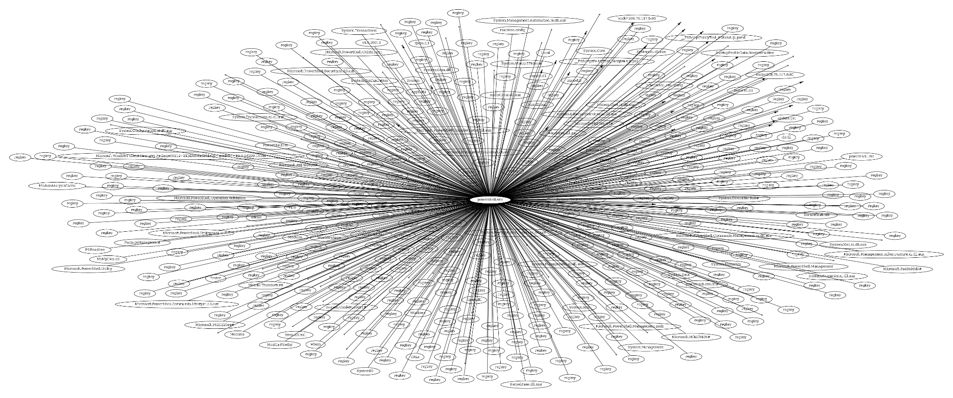
4.4: FiveDirections excel: Partial Attack (powershell)
|V| = 572, |E| = 2,333. Had trouble connecting these two parts together
Malicious powershell.exe

Slide 35
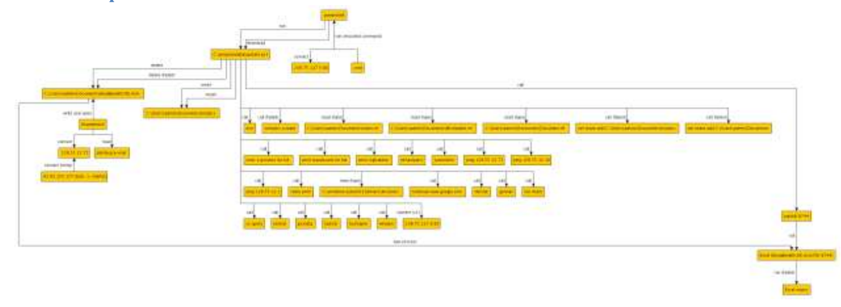
4.4: FiveDirections excel: Ground Truth

Slide 36
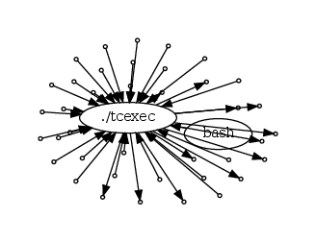
4.8: THEIA executable: Failed Attack
|V| = 41, |E| = 52
Red team manually ran malicious tcexec from bash

Slide 37
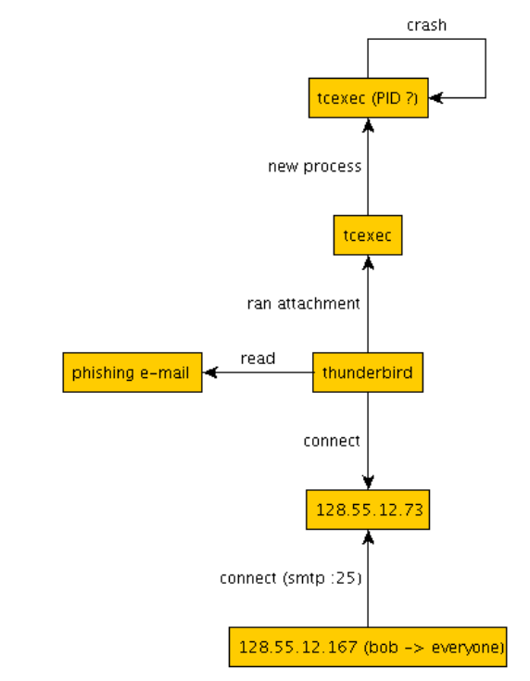
4.8: THEIA executable: Ground Truth
Did not include this as it is indistinguishable from benign activity

Slide 38
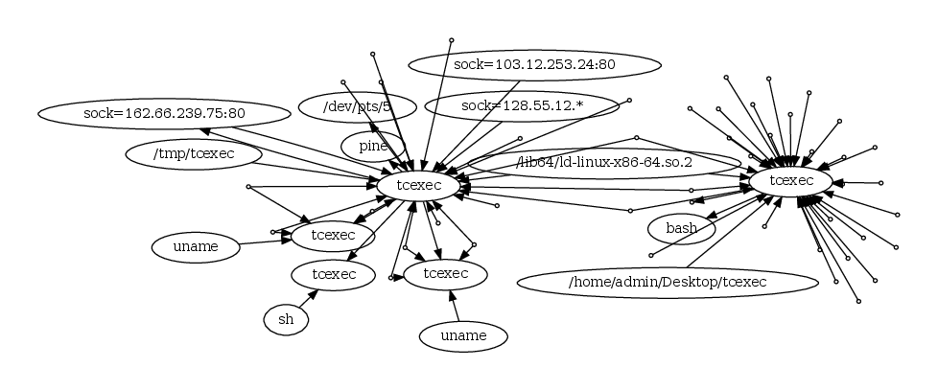
4.9: TRACE executable: Successful Attack
|V| = 67,398, |E| = 134,639. Large due to port scanning
Scanned ports elided for space
Source is pine

Slide 39
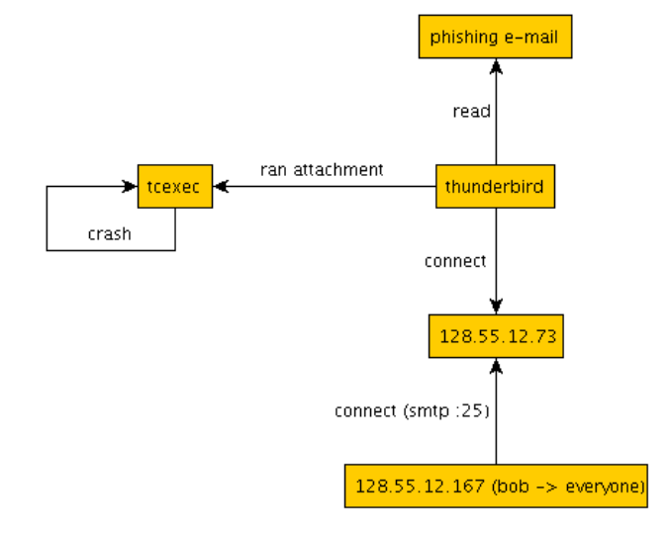
4.9: TRACE executable: Ground Truth
This is clearly the wrong ground truth

Slide 40
4.9: TRACE pine: Real Ground Truth
This was the 3.15 graph!
pine
/tmp/tcexec
Phishing e-mail

